Slide 1
Shifting and Scaling Graphs of Functions
All slides in this presentations are based on the book Functions, Data and Models, S.P. Gordon and F. S Gordon ISBN 978-0-88385-767-0

Slide 2
Building New Functions From Old
Four Ways to build new functions from old:
By adding or subtracting a constant from the function y
By adding or subtracting a constant from the independent variable x
By multiplying the function y by a constant
By multiplying the independent variable x by a constant.

Slide 3
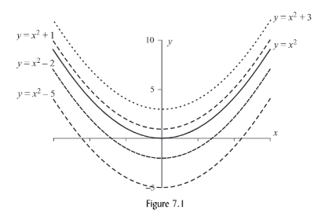
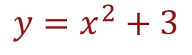
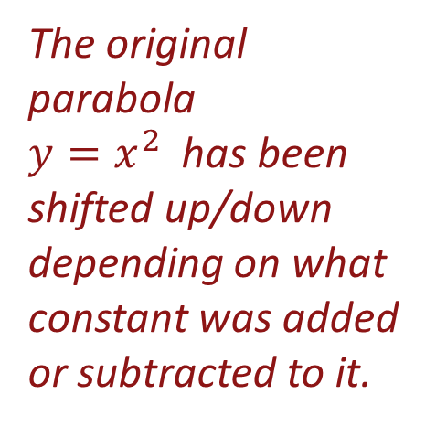
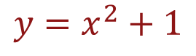
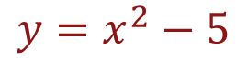
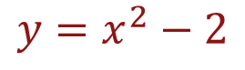
Example of Vertical Shifting
Consider y = f(x) = x² and four related quadratic functions
$$y=x^{2}+1$$
$$y=x^{2}−2$$
Look at the graphs of all these functions in figure 7.1
$$y=x^{2}+3$$
$$y=x^{2}−5$$
The original parabola
$y=x^{2}$ has been shifted up/down depending on what constant was added or subtracted to it.

Slide 4
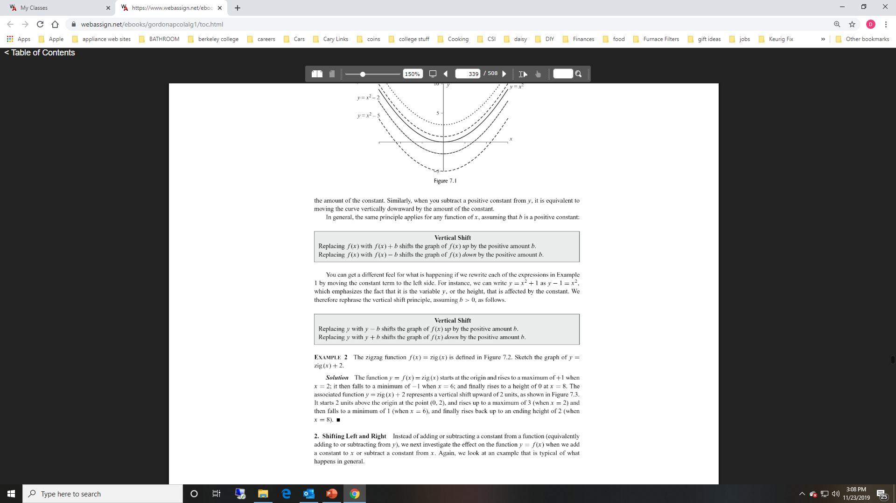
Vertical Shifting Summary

Slide 5
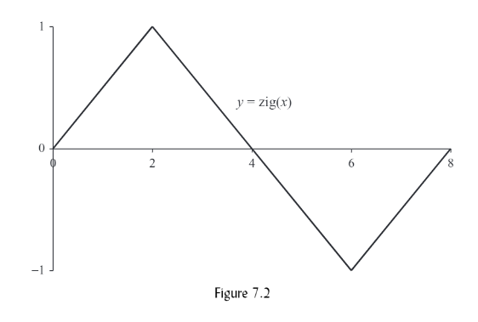
Example the Zigzag Function
The function f(x) = zig (x) is shown below in figure 7.2
Table of values of the graph

Slide 6
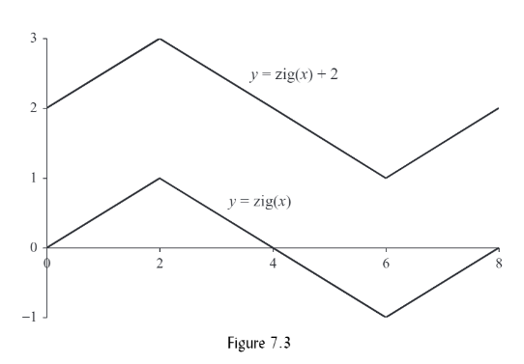
Example the Zigzag Function Continued
Let’s examine y= zig (x) + 2 shown below in figure 7.3
All values of y have increased by 2 in the new function y = zig(x)+2

Slide 7
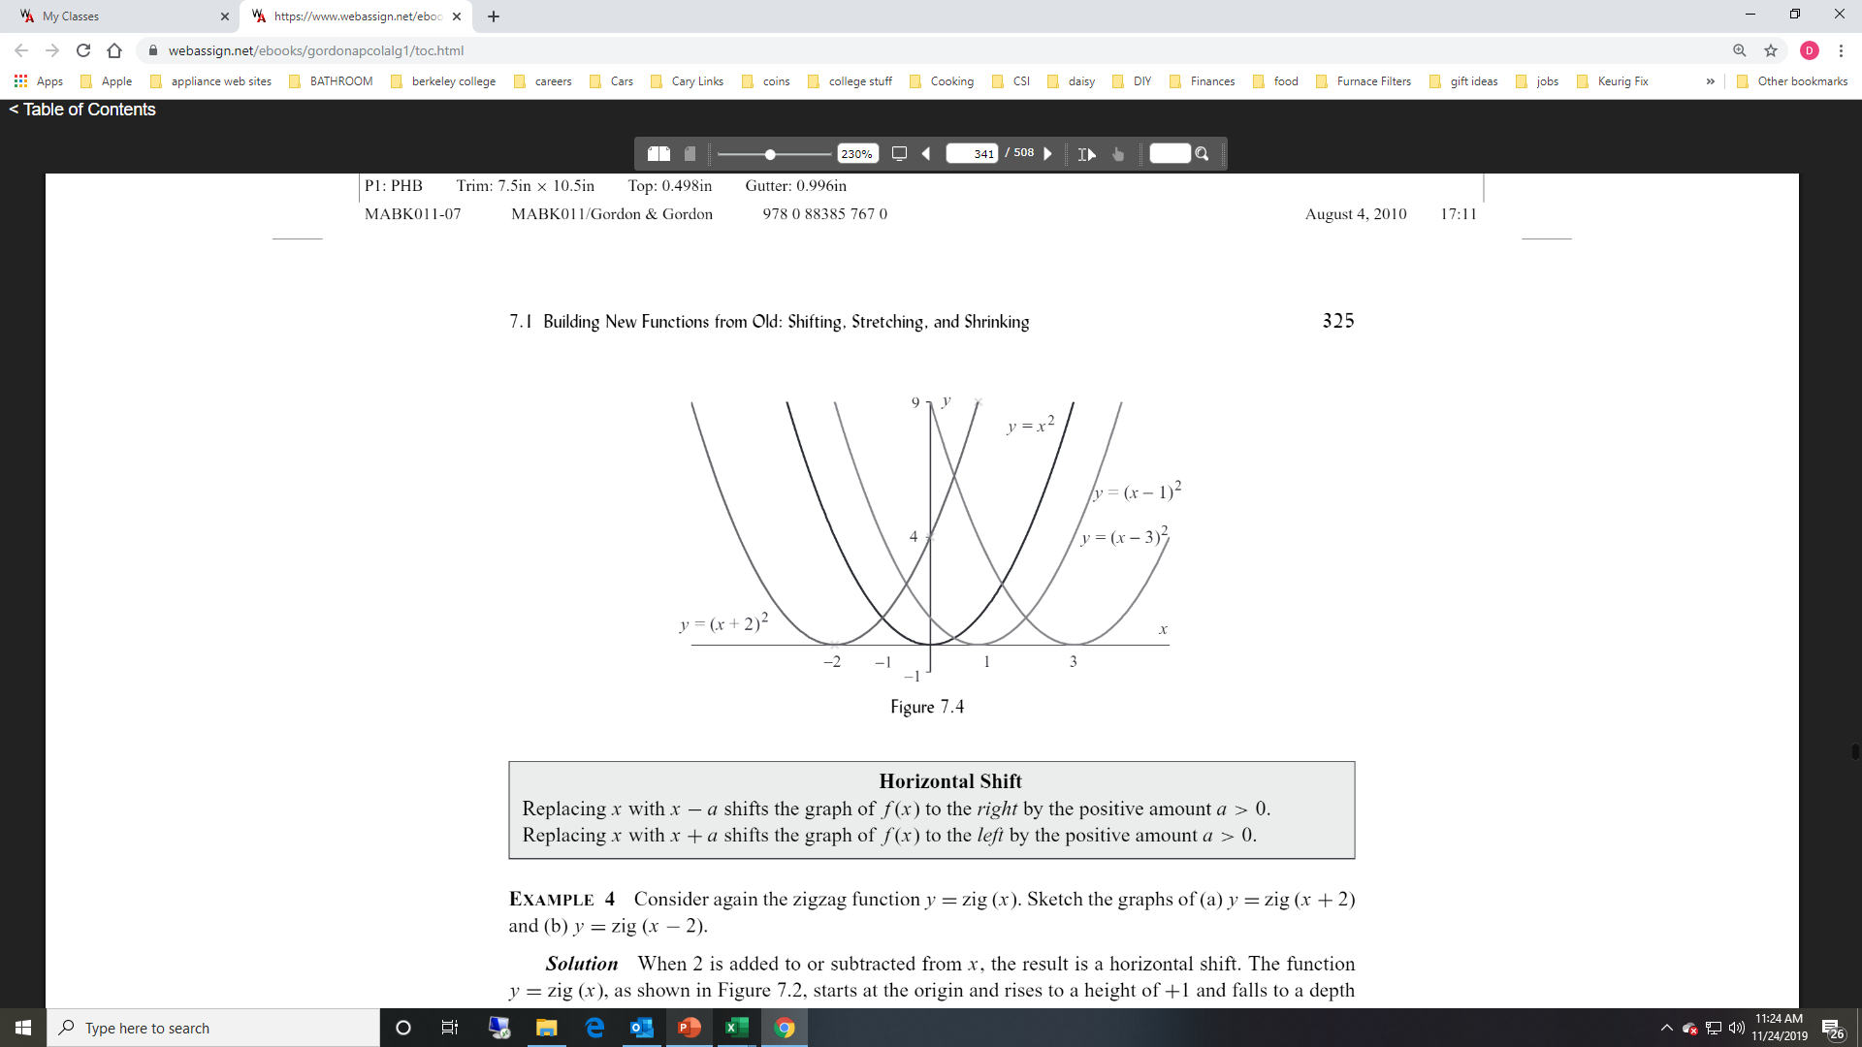
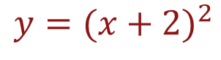
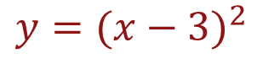
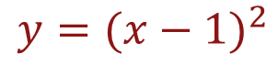
Example Impact on f(x) when Adding/Subtracting a Constant to X
Consider $f\left(x\right)= x^{2} and the functions listed below$
$$y={(x−1)}^{2}$$
$$y={(x−3)}^{2}$$
What is the effect of the constant in each of these functions? (see figure 7.4)
$$y={(x+2)}^{2}$$

Slide 8
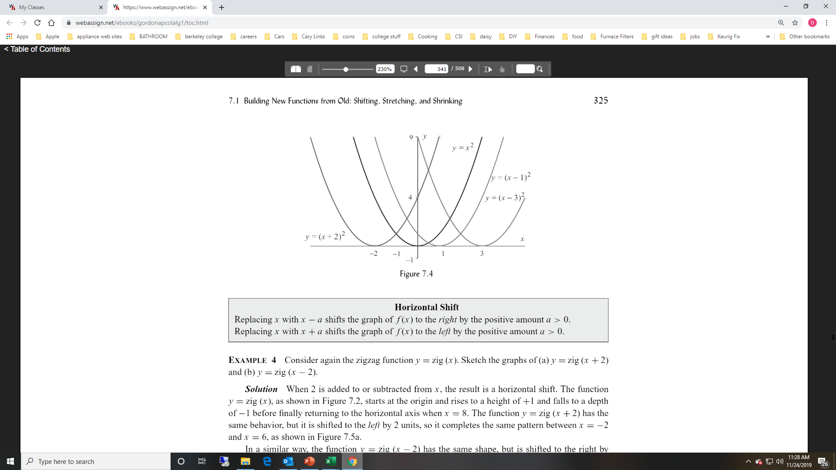
Definition of Horizontal Shift

Slide 9
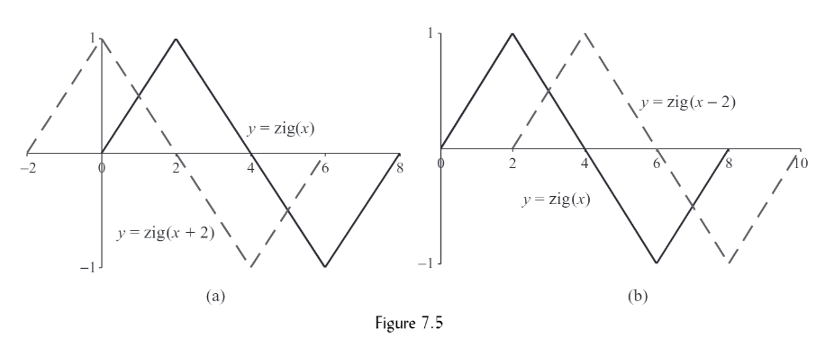
Example of Horizontal Shift
Solution
See Figure 7.5
The graph y = zig(x + 2) is simply shifted 2 units to the left of y = zig( x ). (Notice for y = zig(x + 2) we start the graph at x = -2 and end the graph at x = 6)
The graph y = zig(x - 2) is simply shifted 2 units to the right of y = zig( x ). (Notice for y = zig(x - 2) we start the graph at x = 2 and end the graph at
x = 10)

Slide 10
Summary of Horizontal and Vertical Shifting
When replacing x by x – a, when a > 0, we are changing x and produce a horizontal shift to the right of a units
When replacing x by x + a, when a > 0, we are changing x and produce a horizontal shift to the left of a units
When replacing y by y – b, when b > 0, which is equivalent to replacing f(x) by f(x) – b, we are changing y and produce a vertical shift above of b units
When replacing y by y + b, when b > 0, which is equivalent to replacing f(x) by f(x) + b, we are changing y and produce a vertical shift below of b units

Slide 11
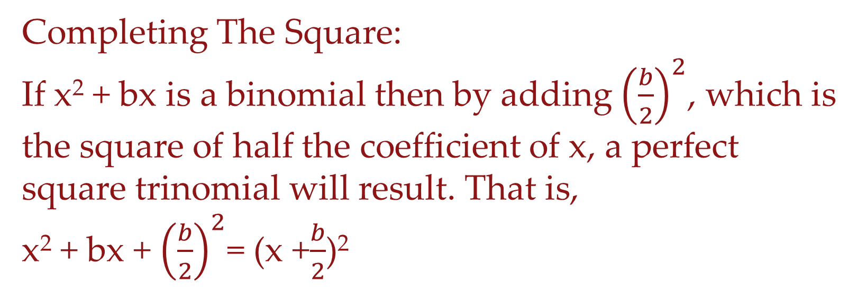
Completing the Square
If a quadratic equation does not factor readily, then we can solve it using the technique of completing the square.
Completing The Square:
If x² + bx is a binomial then by adding ${\left(\frac{b}{2}\right)}^{2}$, which is the square of half the coefficient of x, a perfect square trinomial will result. That is,
x² + bx + ${\left(\frac{b}{2}\right)}^{2}$= (x +$\frac{b}{2}$)²

Slide 12
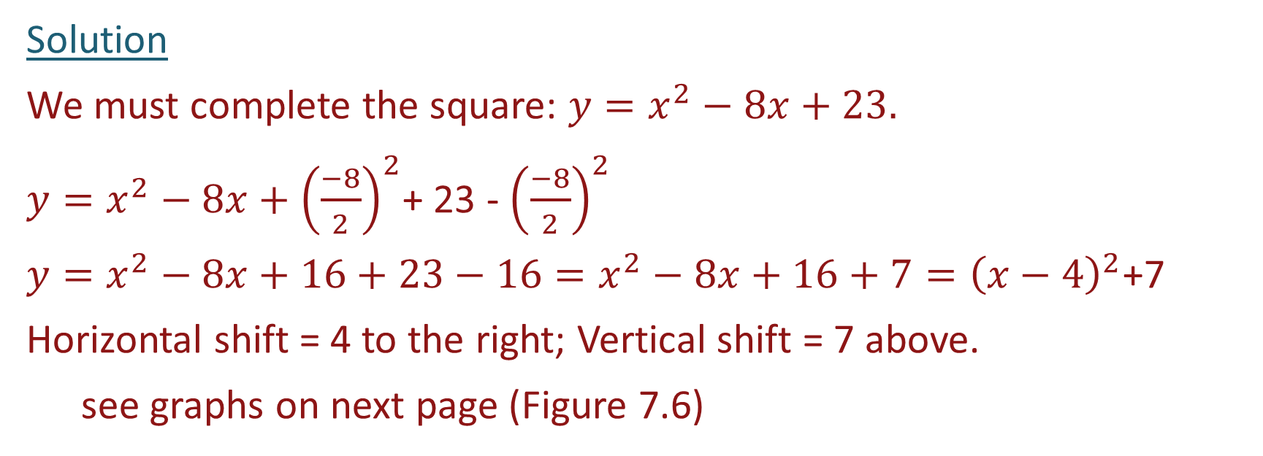
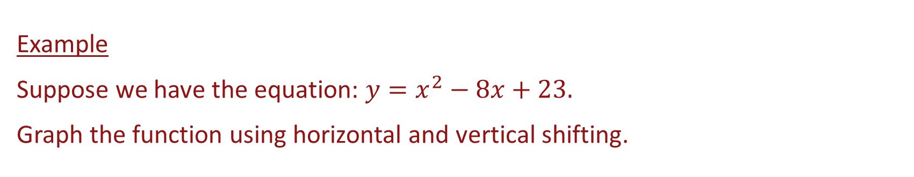
Combined Horizontal and Vertical Shift
Example
Suppose we have the equation: $y=x^{2}−8x+23.$
Graph the function using horizontal and vertical shifting.
Solution
We must complete the square: $y=x^{2}−8x+23.$
$y=x^{2}−8x+{\left(\frac{−8}{2}\right)}^{2}$+ 23 - ${\left(\frac{−8}{2}\right)}^{2}$
$y=x^{2}−8x+16+23−16=x^{2}−8x+16+7={\left(x−4\right)}^{2}$+7
Horizontal shift = 4 to the right; Vertical shift = 7 above.
see graphs on next page (Figure 7.6)

Slide 13
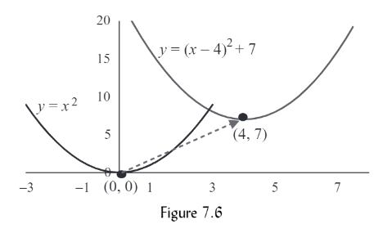
Example Continued

Slide 14
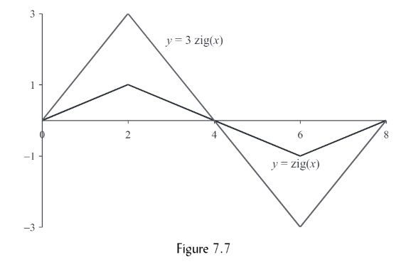
Vertical Stretching
Example
Sketch the graph of Y = zig (x) and y = 3·zig(x)
Let’s look at the table of values below and the graph of both functions to the right in Figure 7.7
Note: Every value of y in the graph
y = 3 zig(x) increases by a factor of 3 compared to the graph y = zig (3)

Slide 15
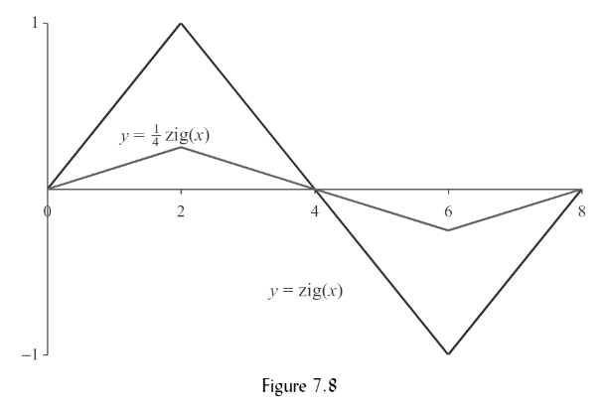
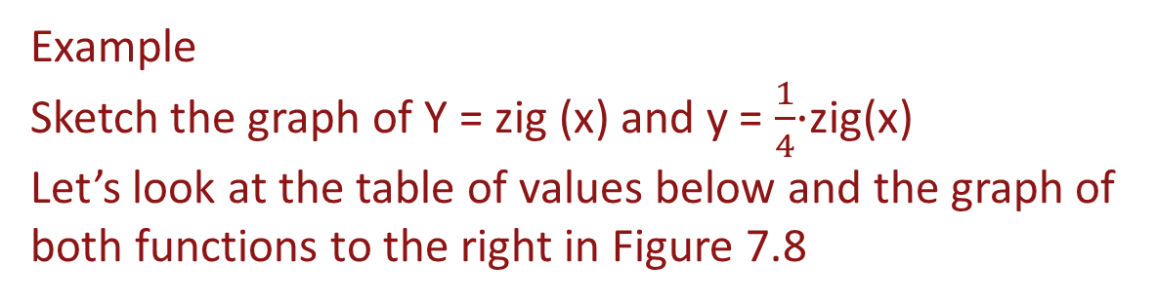
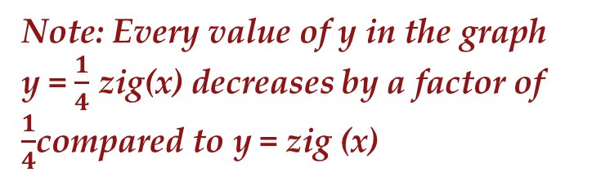
Vertical Shrinking
Example
Sketch the graph of Y = zig (x) and y = $\frac{1}{4}$·zig(x)
Let’s look at the table of values below and the graph of both functions to the right in Figure 7.8
Note: Every value of y in the graph
y = $\frac{1}{4}$ zig(x) decreases by a factor of $\frac{1}{4}$compared to y = zig (x)

Slide 16
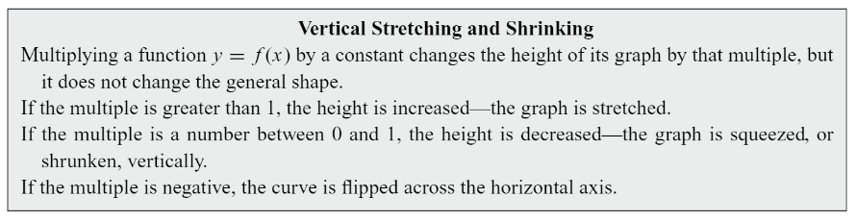
Summary Vertical Stretching and Shrinking

Slide 17
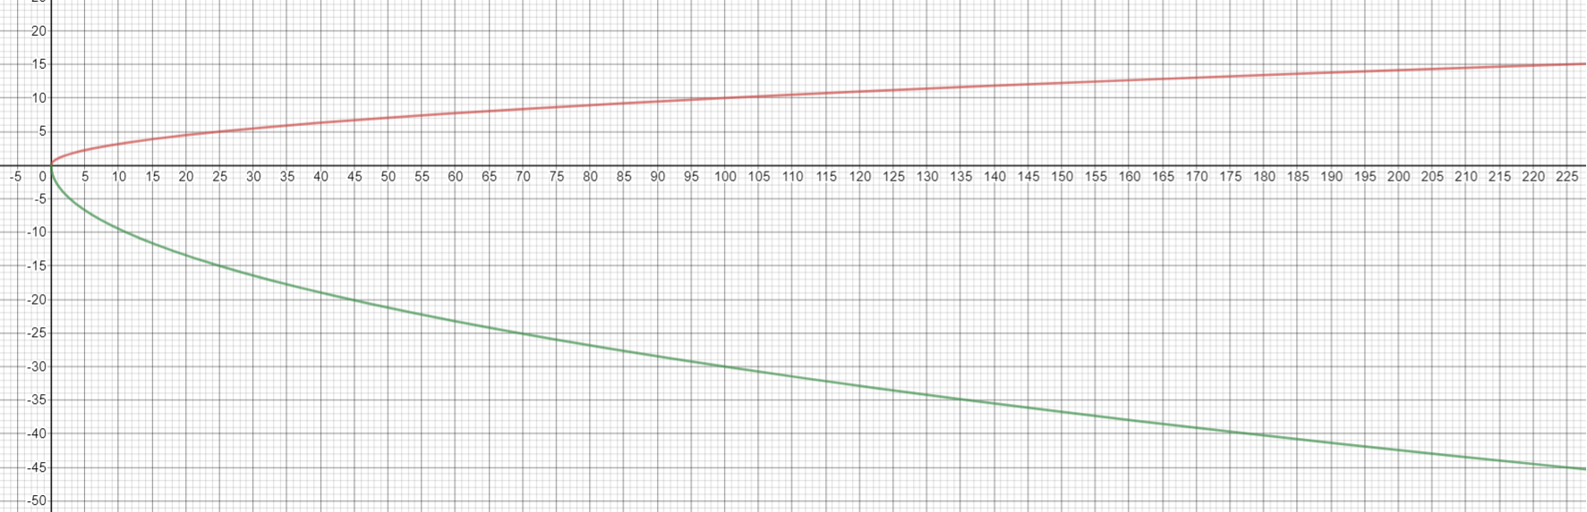
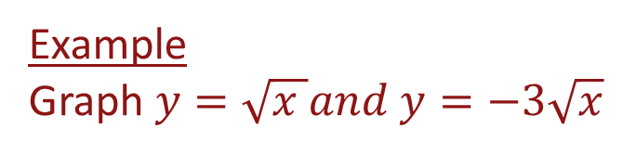
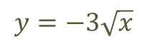
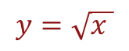
Negative Factor Stretching Example
Example
Graph $y=\sqrt{x }and y=−3\sqrt{x}$
$$y=\sqrt{x }$$
$$y=−3\sqrt{x}$$

Slide 18
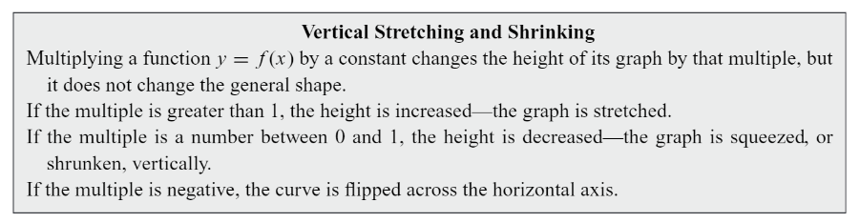
Vertical Stretching and Shrinking Summary

Slide 19
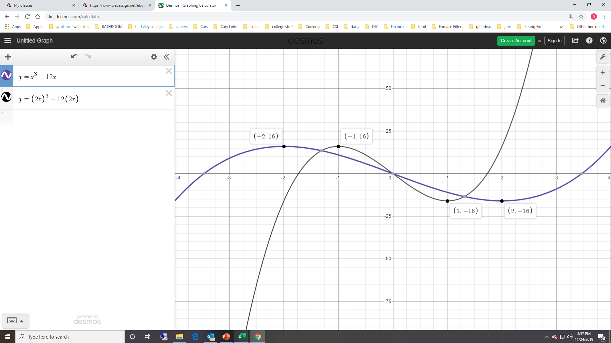

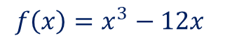
Horizontal Shrinking
$$consider f\left(x\right)=x^{3}−12x and$$
$$f\left(2x\right)={(2x)}^{3}−12\left(2x\right)=8x^{3}−24x$$
$$f\left(2x\right)=8x^{3}−24x$$
Both functions have two turning points with the exact same y values and both functions pass through the origin. The curve y = f(2x) traces out identical vertical values as f(x), but it does so twice as fast in either direction starting at x = 0.
$$f\left(x\right)=x^{3}−12x$$

Slide 20
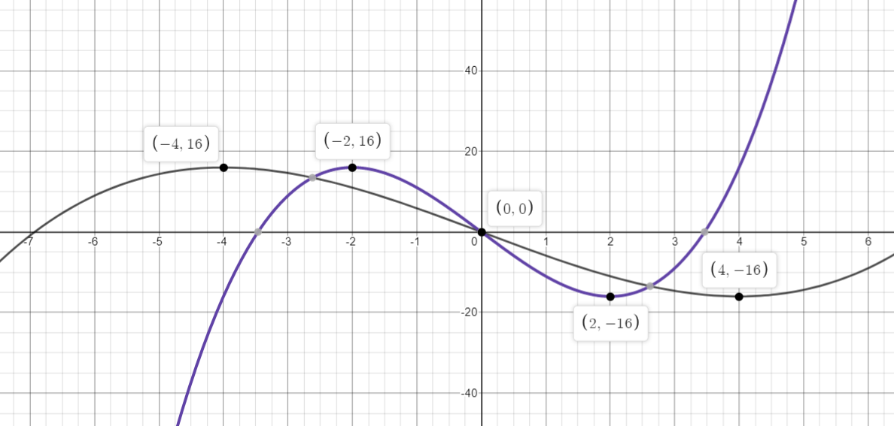
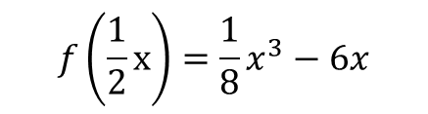
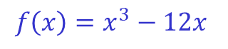
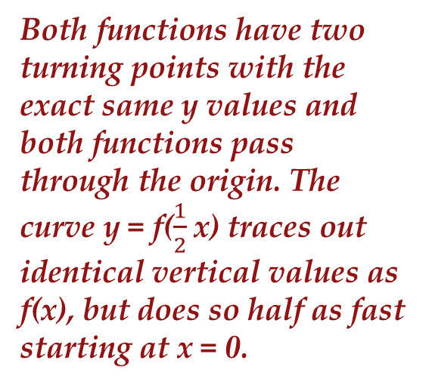
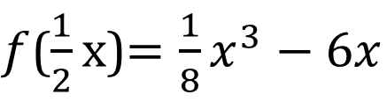
Horizontal Stretching
$$consider f\left(x\right)=x^{3}−12x and$$
$f$($\frac{1}{2}x$)$=\frac{1}{8}x^{3}−6x$
Both functions have two turning points with the exact same y values and both functions pass through the origin. The curve y = f($\frac{1}{2}$x) traces out identical vertical values as f(x), but does so half as fast starting at x = 0.
$$f\left(\frac{1}{2}x\right)=\frac{1}{8}x^{3}−6x$$
$$f\left(x\right)=x^{3}−12x$$

Slide 21
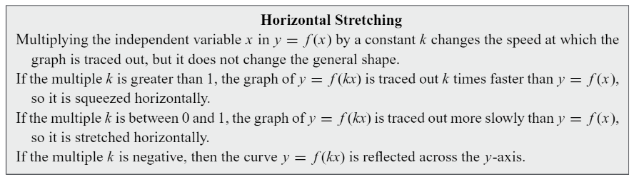
Summary Horizontal Stretching and Shrinking

Slide 22
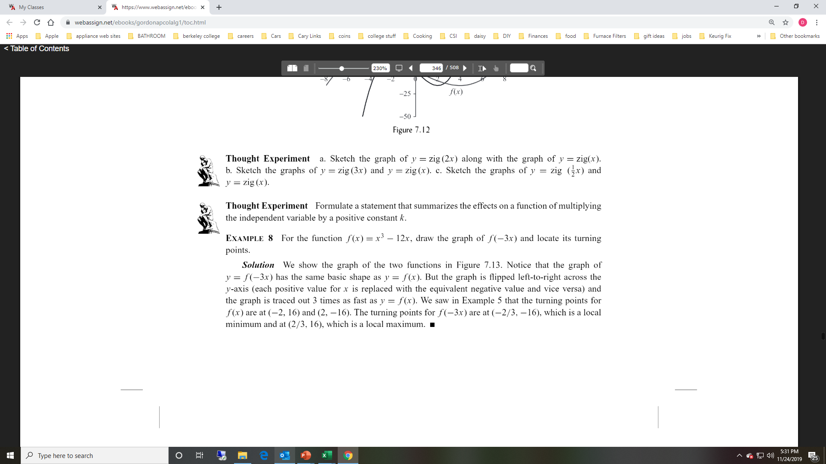
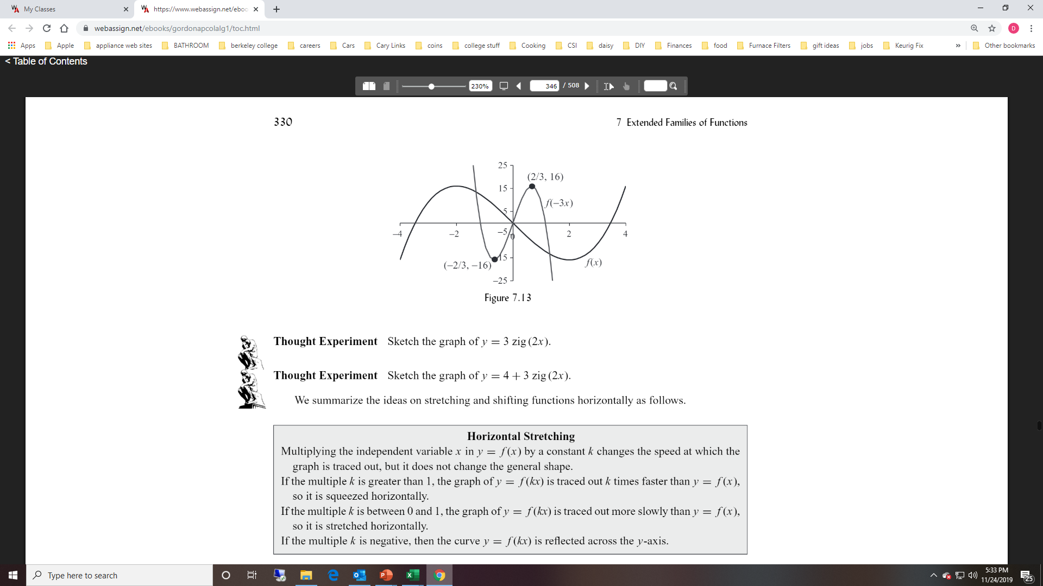
Negative Factor for Horizontal Shrinking

Slide 23
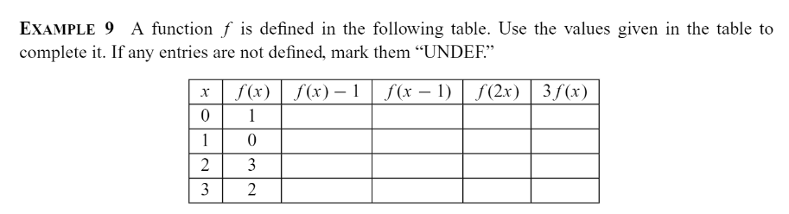
Example

